Slide 1
Business Mission to USA
Chicago, Portland & Seattle
September 22nd – 29th, 2018
BUSINESS MISSION BENEFITS
Exchange of know-how and business model
One-to-one meetings
Rroundtables with the business community on local business practices and opportunities
Site visits to local facilities

Slide 2
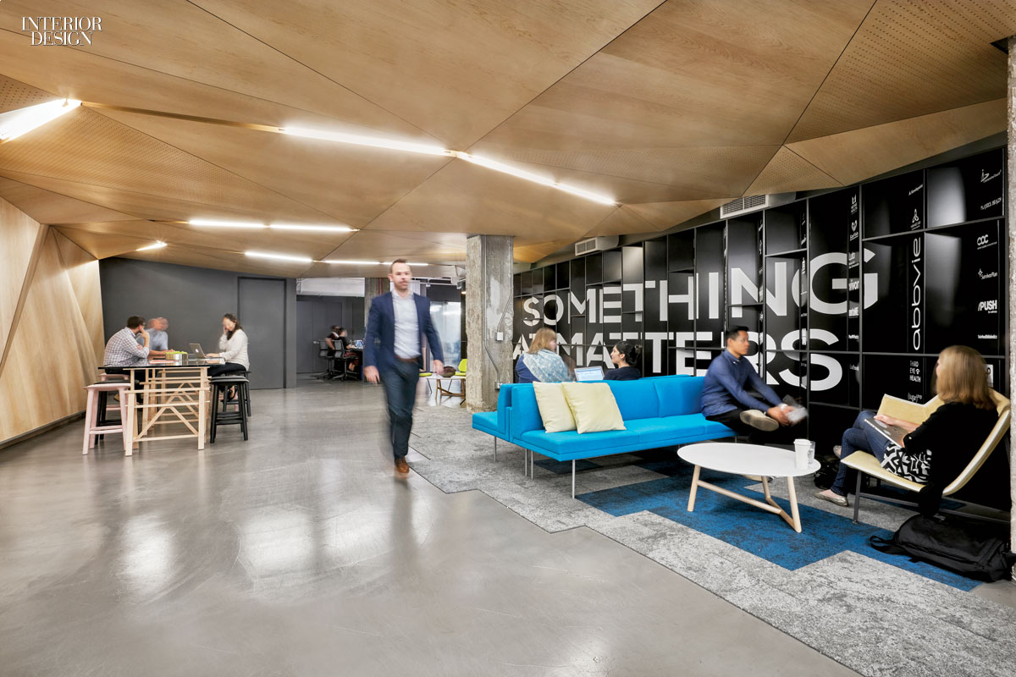
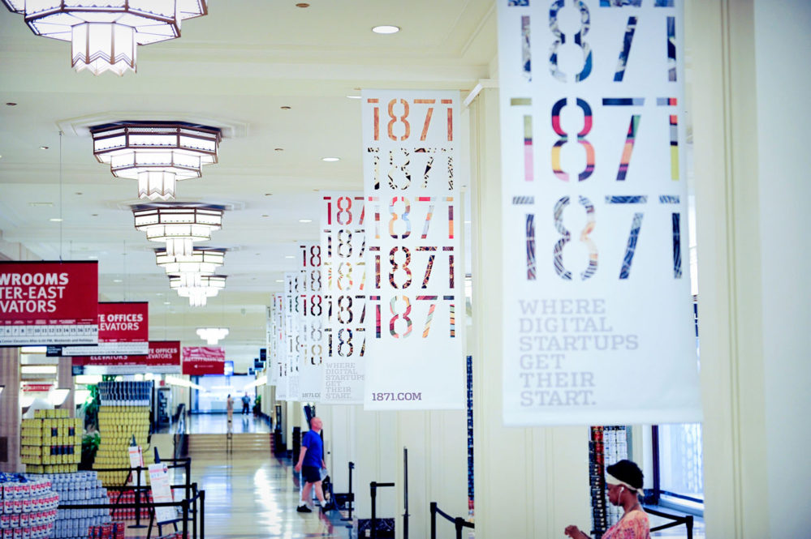
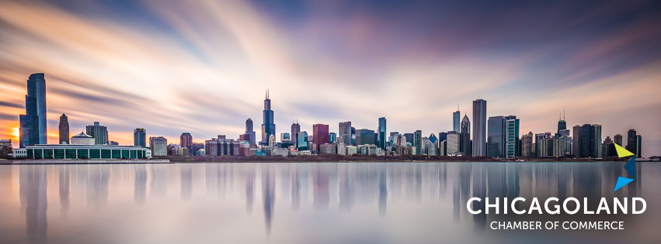
Why Chicago?
Healthcare
Hosts the largest urban medical district in the United States
Seven of the United State's 12 health-care-focused private-equity firms are based in Chicago
Home to more than 40 national medical and health association headquarters
IT&C
Home to 1871 ranked first in the world in the 2018 UBI Global list of Top University-Affiliated Business Incubators
Thriving technology and entrepreneurial ecosystem
Business Organizations
Chicagoland Chamber of Commerce – Chicago’s most influential business organization
International Trade Association of Grater Chicago – largest trade association in Illinois
Chicagoland’s Food and Beverage Network – represents the second largest food & beverages industry is in the US

Slide 3
HEALTH CARE INDUSTRY
IN CHICAGO
Health Services Sector – Key Data
Gross Regional Product
$55.9 Billion
Workforce
614,608 Employees
Number of Companies
26,542
Medical Technology Sector – Key Data
Gross Regional Product
$4.8 Billion
Workforce
26,634 Employees
Number of Companies
890

Slide 4
TENTATIVE
PROGRAM
CHICAGO HEALTH CARE INDUSTRY
MATTER
Healthcare Innovators Hub
Curriculum built to educate entrepreneurs on how to recruit founders and employees, raise money, identify and approach customers, shorten sales cycles, build pipelines, and scale up for success
Mentors-in-residence who’ve built healthcare businesses and have deep expertise in healthcare, technology, and entrepreneurship
Access to innovators from across the healthcare ecosystem including pharmaceutical, medical device, diagnostics, and health IT companies; venture capitalists; health systems and hospitals; payers; scientists; and physicians
www.matter.health

Slide 5
TENTATIVE
PROGRAM
CHICAGO HEALTH CARE INDUSTRY
Illinois Medical District
Largest Medical District in USA
A special-use zoning district in Chicago of 560 acres of medical research facilities, labs, a biotechnology business incubator, a raw development area, four major hospitals, two medical universities, and more than 40 health care related facilities
The IMD is the largest urban medical district in the United States and has the most diverse patient population in the country
The district is focused on expanding innovation in healthcare, medical science, information technology, biotechnology, medical devices, clean technology and supportive assisted living.
www.imdc.org

Slide 6
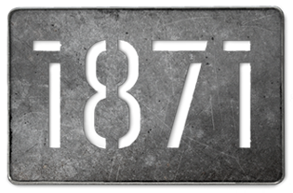
TENTATIVE
PROGRAM
CHICAGO IT&C INDUSTRY
1871
Top-ranked Tech Incubator in the World
1871 is the home of more than 400 early-stage, high-growth digital startups.
A 150,000 square foot facility is also the headquarters of nationally recognized accelerators, industry-specific incubators, tech talent schools, the Illinois Science and Technology Coalition — the state’s leading technology advocate, a number of Chicago-based VCs, and satellite offices for Northwestern University, University of Illinois, University of Chicago, Loyola University Chicago, Illinois Institute of Technology, DeVry University, and DePaul University.
It has become the hub for the city’s thriving technology and entrepreneurial ecosystem.
https://1871.com/

Slide 7
TENTATIVE
PROGRAM
CHICAGO IT&C INDUSTRY
Illinois Science & Technology Coalition
Technology Innovators Hub
ISTC members are leaders in the innovation ecosystem and include major Illinois research universities, federal labs, Fortune 500 corporations, and civic organizations.
Illinois Corporate-Startup Challenge - is a national award–winning program that connects global corporations with the entrepreneurial community for mutual benefit.
Energy Innovation - ISTC plays an active role in a number of partnerships to support energy innovation (Energy Foundry, Illinois Science and Energy Innovation Foundation (ISEIF), Smart Grid Cluster).
www.istcoalition.org

Slide 8
TENTATIVE
PROGRAM
CHICAGO BUSINESS ORGANIZATIONS
Chicagoland Chamber of Commerce
Chicago’s Most Influential Business Organization
Members represent a diverse cross-section of our economy, including small and emerging businesses, mid-market companies, large corporations, and multi-nationals.
The Chamber Board and Executive Committee include senior executives from Fortune 500 companies, small businesses, multi-nationals, top global consultancies, major banks, and media networks.
Educational programs offer crucial business updates on topics including technology, marketing, and international commerce.
The Chamber is also home to Small Business Chicago, the Illinois Small Business Development Center and an International Business Team.
www.chicagolandchamber.org

Slide 9
TENTATIVE
PROGRAM
CHICAGO TRADE ORGANIZATIONS
International Trade Association of Grater Chicago
Largest Association of its kind in Illinois
With more than 500 members representing a range of interests – industrial, merchandise, and service companies, consular/diplomatic groups, and academic organizations.
Receiver of the United States of America’s highest international trade award, the President’s “E” Award for Export Service
Produces and distributes the well-known Illinois International Business Calendar.
www.itagc.org

Slide 10
TENTATIVE
PROGRAM
CHICAGO FOOD INDUSTRY
Chicagoland Food & Beverages Network
Chicagoland’s Food and Beverage industry is the second largest in the US. Approximately 4,500 firms make up the cluster, accounting for 130,000 employees and $32 billion in sales.
Chicagoland Food & Beverage Network includes dozens of business types making a wide range of food products including: Baked Goods; Specialty Food and Ingredients; Beverages; Meat, Poultry and Seafood Processing; Candy and Chocolate; Dairy Products; Packaged Fruits and Vegetables; Milling and Refining of Cereals, Oilseeds and Sugar.
It also includes suppliers of packaging materials, equipment, machinery and transportation services, and the full range consulting and support services that are critical to supporting food and beverage companies and bringing their products to the marketplace.
www.chicagolandfoof.org

Slide 11
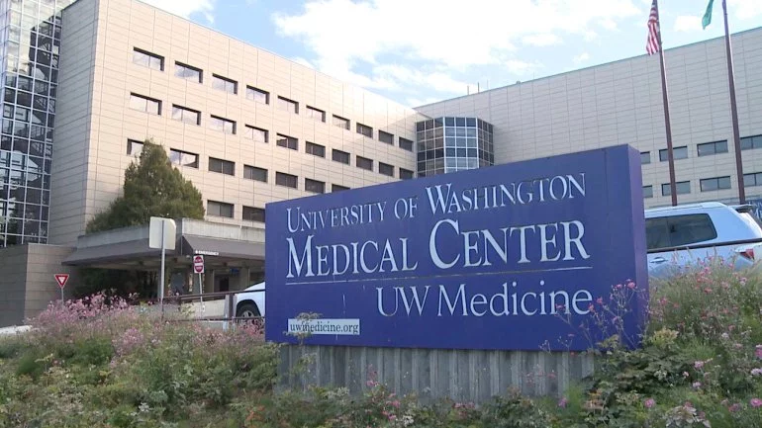
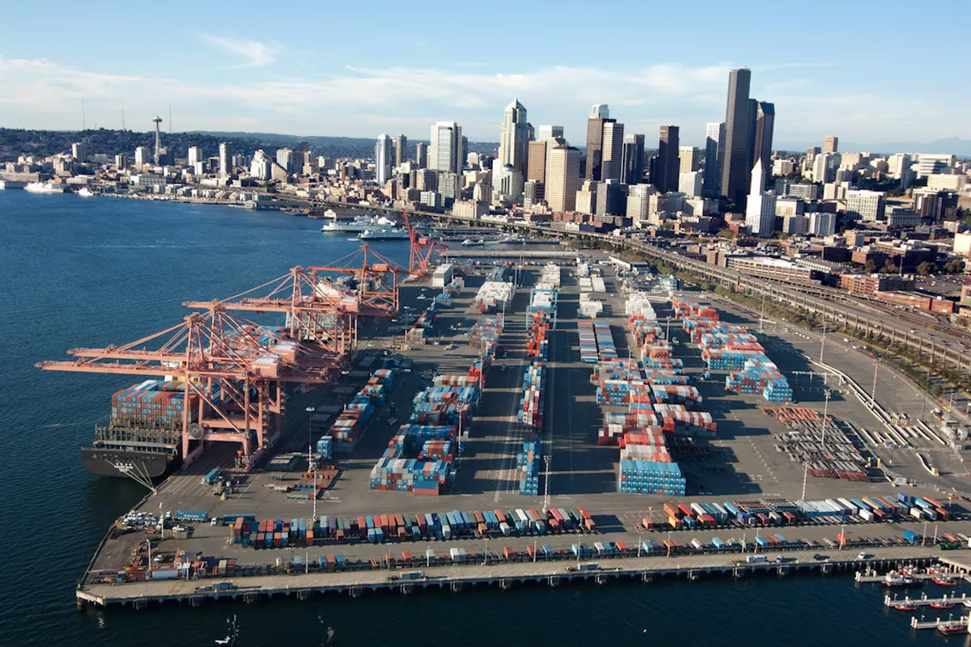
Why Seattle?
Healthcare
Seattle healthcare system supports one of the world’s largest and most comprehensive medical research programs
University of Washington is consistently ranked among the country's top leading institutions in medical research
Harborview Medical Center is the only Level I trauma hospital in a region that includes Washington, Alaska, Montana, and Idaho
IT&C
A fast-growing technology center with a stream of new software, biotechnology, and Internet companies
Both Microsoft and Amazon were founded and established in the Seattle region
Port Infrastructure
Port of Seattle, also operating Seattle–Tacoma International Airport, is a major gateway for trade with Asia and cruises to Alaska
It is the 8th largest port in the United States by its container capacity
Aerospace
Boeing company with its large aircraft manufacturing plants in Everton and Renton is the largest private employer in the Seattle metropolitan area

Slide 12
TENTATIVE
PROGRAM
SEATTLE HEALTH CARE INDUSTRY
UW Medicine
A 30,000 members community advancing the excellence of their work in patient care, medical education and research.​​
UW Medicine’s four hospitals – Harborview Medical Center, Northwest Hospital & Medical Center, University of Washington Medical Center and Valley Medical Center – admit more than 63,000 patients each year. UW Medicine provides outpatient care for more than 1.3 million patients each year at its 12 UW Neighborhood Clinics.
The UW School of Medicine leads the internationally recognized, community-based WWAMI Program, serving the states of Washington, Wyoming, Alaska, Montana and Idaho. The School of Medicine has been ranked No. 1 in the nation in primary-care training for more than 20 years by U.S. News & World Report.
UW Medicine also includes Airlift Northwest and the UW Physicians practice group, the largest physician practice plan in the region.
www.uwmedicine.org

Slide 13
TENTATIVE
PROGRAM
SEATTLE IT&C INDUSTRY
CoMotion Labs
Your Innovation Partner
A multi-industry labs system hosting startups inside and outside the University of Washington community in IT, Engineering, Life Sciences, Medical Devices, Clean Tech and AR/VR. ​​
Its incubators average between 60 to 90 startups ranging from pre-seed to Series A, employing 2 to 15 people each, which are variously headed by students, faculty, and community leaders, with both new and seasoned entrepreneurs represented.
It provides plenty of office space, meeting rooms, as well as chemistry, biology, engineering, augmented and virtual reality labs.
https://comotion.uw.edu/what-we-do/comotion-labs/home/

Slide 14
TENTATIVE
PROGRAM
SEATTLE IT&C INDUSTRY
On-site Visits and Meetings

Slide 15
TENTATIVE
PROGRAM
SEATTLE PORT IFRASTRUCTURE
Port of Seattle
The Port of Seattle is a governmental body administering Seattle's seaport and airport.
Its portfolio of properties ranges from parks and waterfront real estate, to one of the largest airports and container terminals on the West Coast, the Port of Seattle is one of the Pacific Northwest’s leading economic engines
Envisaged partnerships between the Port of Seattle and the Romanian Maritime Ports Administration (Port of Constanza)
SEA-TAC-AIRPORT’s business model and administration of interest for Bucharest International Airport.
www.portseattle.org

Slide 16
TENTATIVE
PROGRAM
SEATTLE BUSINESS ORGANIZATIONS
Seattle Metropolitan Chamber of Commerce
The Seattle Metropolitan Chamber of Commerce is the largest and most diverse business association in the region.
The Chamber represents 2,200 companies and a regional workforce of approximately 700,000.
Six business and economic development organizations are affiliated with the Chamber: Alliance for Education, Economic Development Council of Seattle and King County, Leadership Tomorrow, Technology Alliance, Trade Development Alliance of Greater Seattle, and the Washington Council on International Trade.
www.seattlechamber.com

Slide 17
TENTATIVE
PROGRAM
SEATTLE TRADE ORGANIZATIONS
Trade Development Alliance of Grater Seattle
Trade Development Alliance (TDA) promotes the Greater Seattle region in global markets, connecting the region and its businesses to those markets, bringing the region together to be more globally successful and educating the region on the importance of engaging in international business and trade.
The Trade Alliance is a regional partnership of the following entities: Snohomish County, King County, Pierce County, Port of Everett, Port of Seattle, Port of Tacoma, City of Everett, City of Bellevue, City of Seattle, City of Tacoma, the Seattle Metropolitan Chamber of Commerce.
The Trade Development Alliance holds Memorandum of Understanding (MOUs) with many major global markets – Asia, Middle East, Europe, Africa and Oceania.
www.seattletradealliance.com

Slide 18
TENTATIVE
PROGRAM
SEATTLE AEROSPACE INDUSTRY
Boeing Everett Factory
The Boeing Everett Factory is an airplane assembly building owned by Boeing.
It is the largest building in the world by volume at 13,385,378 m3 (472,370,319 cu ft) and covers 399,480 m2 (98.7 acres).
This is the factory where the wide-body Boeing 747, 767, 777, and 787 are assembled.
On-site visits and meetings

Slide 19
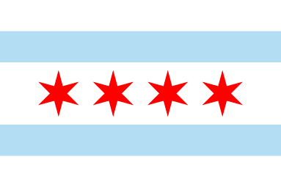
TENTATIVE
PROGRAM
US LOCAL ADMINISTRATION AUTHORITIES
Local Administration Authorities
Meetings with the US local authorities representatives
Concluding strategic partnerships with the US local authorities
Focusing on specific issues:
Waste Management Systems
Administration of university campuses
Healthcare system and medical units administration

